Slide 1
ICE
Business Model Submission
Innovator Name: Shivani Deosatwar
Idea Name:
Bill Data Extraction

Slide 2
Agenda
1
Summary
1
2
Market Overview
3
Summary of the Idea
4
Architecture
5
Future Scope
6
Cost Model
7
Value Proposition

Slide 3



Summary
Text extraction from images of bill that can help in
maintaining the data
This software will extract the required tabular data
and ignore the unnecessary graphics in bills

Slide 4

Problem Statement
Nowadays we get bills in soft copies as well as hard copies.
It has become hard to maintain both types of bills.
This creates problem of maintaining our expenses.

Slide 5

Eureka Moment!!
Digitize
take a picture of it
Crop
Detect boxes and crop
Extract
Extract data from cells

Slide 6
Market Overview
Invoice Capture Software
Recognize all key data fields in your invoices
Returns easy to handle structured data
Veryfi OCR API
Extracts unstructured data from receipts, invoices and bills
Returns the line-items present in document

Slide 7
Summary of the idea
The software extracts the data from bills of a particular template, present in tabular format
Individual cells of the table will be generated by using box detection algorithm
User can select the cells, from which they want data
1
2
3

Slide 8
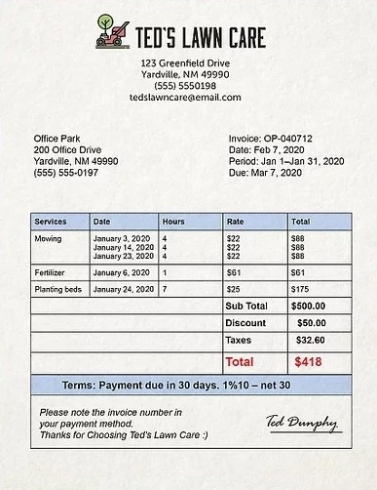
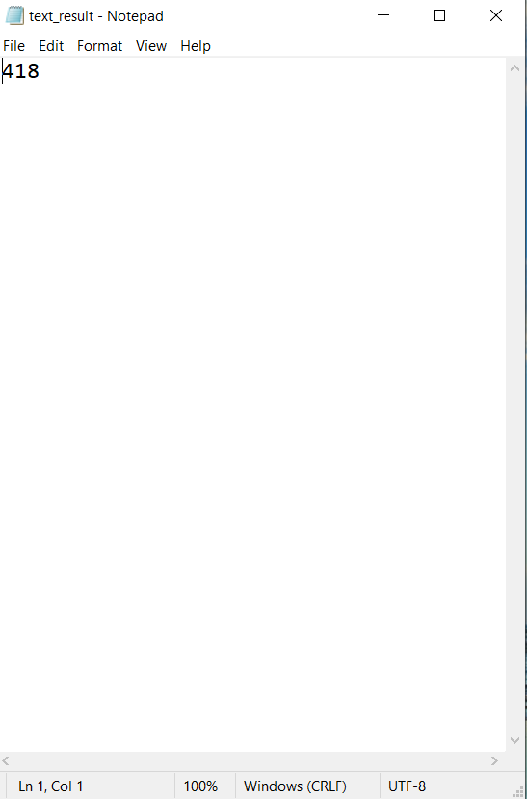
Example

Slide 9
Technology used
OpenCV
Used for real-time computer vision applications
Supported on Windows, Linus, MAC OS and Android
PyTesseract
Text recognizer engine for handling OCR tasks
Supports Formats like TIFF, JPG, PNG for input and Plain text, HTML, PDF for output
Used by Google, Yahoo, Microsoft, Intel, Sony, Honda, Toyota
Has OCR Engine Modes and Page Segmentation modes.

Slide 10




Architecture
Run Box Detection Algorithm
Bill
Image
Bill
Output: Extracted Text
Run OCR
CSV/
XML/
Plain
text
Notes:
labels

Slide 11

Future Scope
Mobile
App
Storage for images
Custom selection
Data maintenance
Search ability
Bill images and
extracted cells
Display data that
matches the keyword
Cells from which data
is to be needed
Extracted data stored
in csv/xml format

Slide 12
Cost Model
Graphic Assets
Storage for images
Google Developer license
$25
Cloud Storage | Free | Pay as you go
GB stored | 5GB | $26/1TB
GB downloaded | 1 GB/day | $120/1TB
Upload operations | 20K/day | $1/200k
Download operations | 50K/day | $1/2500k
Firebase
$20.99

Slide 13

Value Proposition
A provider can extract only the section of total items from bill
A customer can extract only the amount from bill
Soft copies of bills can be stored in app to avoid physical storage

Slide 14
Target Customer
Corporate
Eg: Amdocs
Small Business
Accounting
Everyone
Bill image storage
Expense management
Eg: event management sectors
Eg: people buying electronics
Data transformation into csv/xml format
Bill maintenance
Data extraction

Slide 15
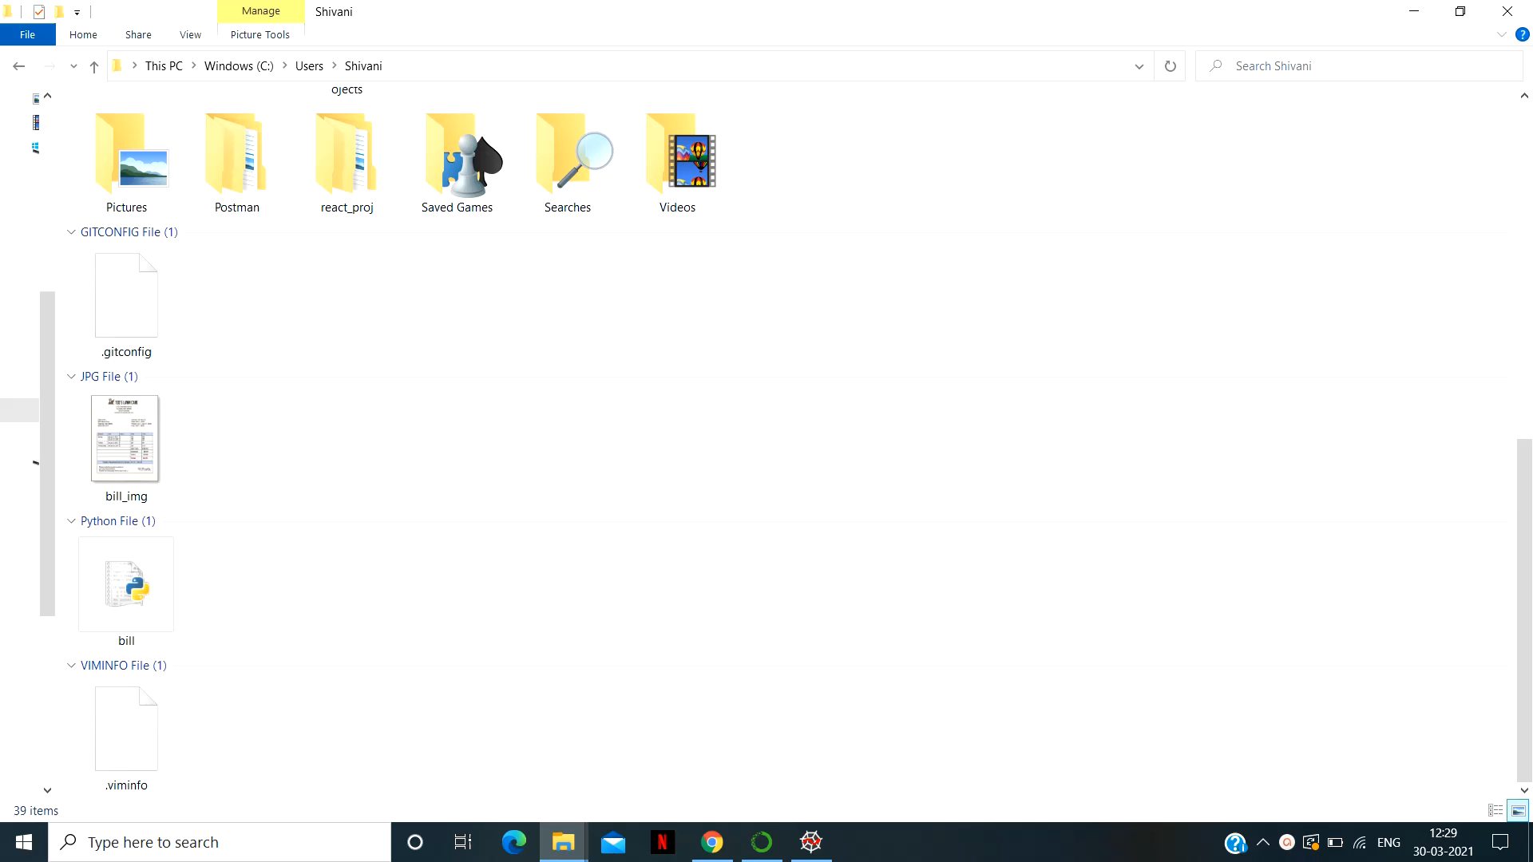
Demo

